Slide 1
Mobile IoT Apps 2
Angular

Slide 2
Angular
https://angular.dev/: Angular is a web framework that empowers developers to build fast, reliable applications.
Oude Angular Website: https://v17.angular.io/docs

Slide 3

Handboek: Angular for Material Design
Studiemateriaal - Theorie
Kotaru. (2020). Angular for Material Design: Leverage Angular Material and TypeScript to Build a Rich User Interface for Web Apps (1st ed. 2020. ed.). Berkeley, CA: Apress : Imprint: Apress. ebook beschikbaar op https://limo.libis.be/VIVES https://doi-org.vives.e-bronnen.be/10.1007/978-1-4842-5434-9 source code: https://github.com/Apress/angular-for-material-design

Slide 4
Angular for Material Design
Inhoud
Introduction
Getting Started
Modules
Angular: Components
Angular: Data Binding and Change Detection
Angular: Directives
Angular: Services and Dependency Injection
Material Design: User Input
Angular: Building Forms
Material Design: Additional Form Fields
Angular: Routing
Material Design: Navigation
Material Design: Layout
Material Design: Using Lists
Material Design: Alerts and Dialogs
Angular: HTTP Client

Slide 5
Angular for Material Design
1 - Introduction
Web technologies
Server => client
standardize Javascript => ECMAScript
Jaarlijks vernieuwd: ES9/ES2018, …

Slide 6
Angular for Material Design
1 - Introduction
A brief history of Angular and its evolution
Open source project van Google
AngularJS 1.x => MV* framework (MVC of MVVM)
Model-View-ViewModel
Model-View-Controller

Slide 7
Angular for Material Design
1 - Introduction
TypeScript
superset of ECMAScript
Datatypes, interfaces, generics en enums
Backed by Microsoft

Slide 8
Angular for Material Design
1 - Introduction
Material Design and the implementation of the Angular design language
Google’s design language
Design language
nabootsen van real-world objecten => vandaar naam material
Kleurschema’s, patronen, texturen, lettertypes
Consistente UI is belangrijk om de gebruiker gemakkelijker te laten navigeren door de App
Angular Material Components: library met componenten die ontworpen zijn volgens Material Design Guidelines

Slide 9
Angular for Material Design
2 – Getting Started
Ontwerp van Hello World App met Typescript en Material Design
Tools
Nodejs
Package manager:
npm of yarn
Installeren en beheren van libraries/apps met bijhorende dependencies
Angular CLI: npm install --global @angular/cli
Visual Studio Code
Git for Windows
GitHub Desktop | Simple collaboration from your desktop

Slide 10
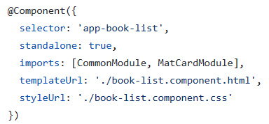
Intermezzo Angular
standalone components
standalone components?
wijziging om complexiteit met modules te vermijden
imports dienen in de component te gebeuren:
klassieke modules kunnen met importProvidersFrom verkregen worden
Klassiek project met modules genereren: ng new --standalone=false => voeg “--standalone=false” toe als je handboek en dia’s volgt
Meer info op [EN] Webinar: What's new in Angular 15? – YouTube

Slide 11
Angular for Material Design
2 – Getting Started
Getting Started with a Sample Application
Option 1: Getting Started Using Angular CLI
ng new superheroes --routing
cd superheroes
ng add @angular/material
npm start
Option 2: Material Design for an Existing Application Without Angular CLI
npm install --save @angular/material @angular/cdk @angular/animations
in style.css: @import "~@angular/material/prebuilt-themes/indigo-pink.css";
in index.html: <link href="https://fonts.googleapis.com/css?family=Roboto:300,400,500" rel="stylesheet"> <link href="https://fonts.googleapis.com/icon?family=Material+Icons" rel="stylesheet">

Slide 12
Angular for Material Design
2 – Getting Started
Add Material Design Code Reference voer ondertaande aanpassingen uit:
Module Reference (p18, listing 2-1)
Modify Template (p19, listing 2-2)
toolbar en card
foutboodschap: Module '"@angular/material"' has no exported member 'MatToolbarModule'. => oplossing:
// Import toolbar and card modules
import { MatToolbarModule } from '@angular/material/toolbar';
import { MatCardModule } from '@angular/material/card';

Slide 13
Angular for Material Design
2 – Getting Started
Sample application die wordt ontworpen:
An intuitive list of superheroes with images and interactive animations
The ability to filter
A detailed information screen for each superhero
A form to create a new superhero
The ability to edit a superhero
hans-naert/superheroes (github.com)
code les

Slide 14
Angular for Material Design
2 – Getting Started
Files and Directories Generated by CLI (tekst in boek p21-p31)
Configuration Files at the Root
Package.json
angular.json
tsconfig.js
tslint.json
Default Application Directory Root: /src
TypeScript Configurations
index.html
main.ts

Slide 15
Angular for Material Design
2 – Getting Started
Files and Directories Generated by CLI (tekst in boek p21-p31)
Application Directory: /src/app
Root Module: app.module.ts
App Component (Root Component)
Routing Module: app-routing.module.ts
Scripts
Start script
Build script
Lint script

Slide 16
Angular for Material Design
3 – Modules
Modules => dependencies beheren
Angular modules, zijn containers voor
componenten
directives
services
…
een andere module gebruiken met behulp van dependency injection

Slide 17
Angular for Material Design
3 – Modules
Javascript modules: import / export
Angular modules
@NgModule decorator: aanmaken van module
imports: modules die "required" zijn kan je hier importeren
declarations: Angular componenten en … die deel uitmaken van de module
bootstrap: rootcomponent van een Angular application
@NgModule({
declarations: [
AppComponent
],
imports: [BrowserModule],
bootstrap: [AppComponent]
})
export class AppModule { }

Slide 18
Angular for Material Design
3 – Modules
Angular module aanmaken: ng generate module superheroes-material-design

Slide 19
Angular for Material Design
3 – Modules
codering superheroes-material-design
listing 3-7 p39
listing 3-8 p40
listing 3-9 p40
More About JavaScript Modules
The Primary Ways to Import and Export Code
Import All

Slide 20
Angular for Material Design
4 - Angular: Components
components
maakt code herbruikbaar in een view
custom element - een custom DOM node
Create a Component
superhero-toolbar: ng generate component superheroes-material-design/superhero-toolbar
superhero-profile: ng generate component superheroes-material-design/superhero-profile listing 4-4 p52

Slide 21
Angular for Material Design
4 - Angular: Components
Create a Component
selector => tag name
templateUrl => url van html code => neem listing 4-6 p53 over
template => inline html
styleUrl => url van css
style => inline css
ecapsulation => css niet globaal
providers => om een instantie van een klasse te maken en in de component te injecteren (dependency injection)
viewProviders => do not provide projected content
<ng-content> voor projecting content => zie listing 4-9 p58

Slide 22
Angular for Material Design
4 - Angular: Components
Create a Component
providers <-> viewProviders:
maak superhero-text.ts (listing 4-11 p59)
gebruik in superhero-profile (listing 4-12 p60)
aangezien de footer projected is, werkt die enkel via "providers" en niet via "viewProviders"

Slide 23
Angular for Material Design
4 - Angular: Components
Input to a component
input voor een angular component => element attributes
@Input() directive
listing 4-15 en 4-16 p62
extensie om automatisch nodige modules importen, …
Validate Input with a Setter (listing 4-17)
Validate Input with the ngOnChanges Lifecycle Hook (listing 4-18)

Slide 24
Angular for Material Design
4 - Angular: Components
Output from a Component
emitting events (listing 4-19 tot en met 4-22)

Slide 25
Angular for Material Design
4 - Angular: Components
Lifecycle Hooks
ngOnInit()
ngOnDestroy()
ngOnChanges()
ngDoCheck()
gAfterViewInit() en ngAfterViewChecked()
ngAfterContentInit() en ngAfterContentChecked()

Slide 26
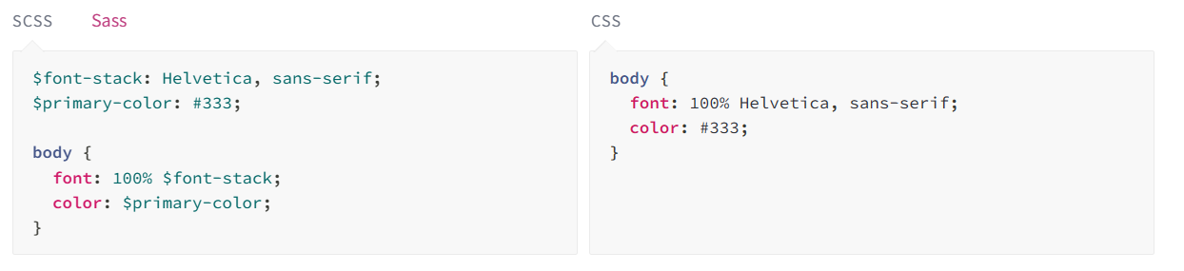
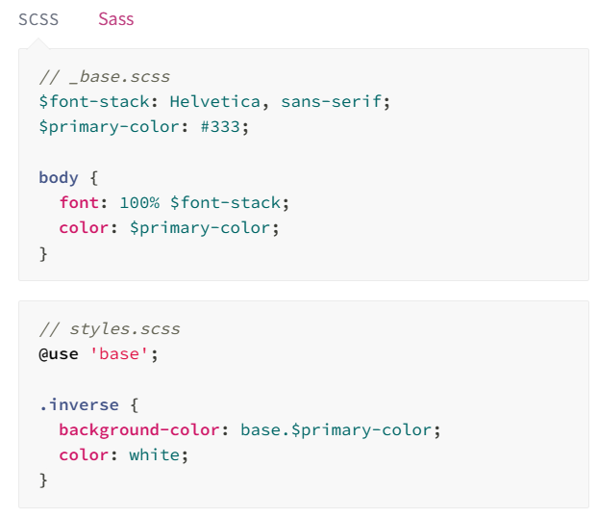
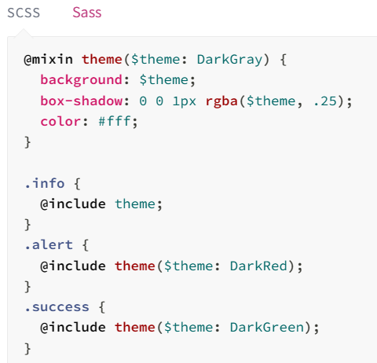
Intermezzo SCSS
Thema kleuren gebruiken in eigen CSS (1/3)
Sass: Sass: Sass Basics (sass-lang.com)
Modules en Mixins

Slide 27
Intermezzo SCSS
Thema kleuren gebruiken in eigen CSS (2/3)
Gebruik Sass in Angular project: extensie scss
Thema zelf definiëren in Sass zodat variabelen op andere plaatsen bereikbaar zijn: (info op Theming Angular Material | Angular Material)
styles.scss:
:root {
@include mat.all-component-themes($angular-app-scss-theme);
}
html, body { height: 100%; }
body { margin: 0; font-family: Roboto, "Helvetica Neue", sans-serif; }
@use '@angular/material' as mat;
@include mat.core();
$angular-app-scss-theme: mat.define-theme((
color: (
theme-type: light,
primary: mat.$azure-palette,
tertiary: mat.$blue-palette,
),
density: (
scale: 0,
)
));

Slide 28
Intermezzo SCSS
Thema kleuren gebruiken in eigen CSS (3/3)
Gebruik thema kleuren in SCSS: Theming Angular Material | Angular Material
Voeg het pad naar styles.scss toe aan de build options
Codevoorbeeld: hans-naert/angular-app-scss (github.com)
@use '@angular/material' as mat;
@import 'styles.scss';
p {
color: mat.get-theme-color($angular-app-scss-theme, on-primary);
background-color: mat.get-theme-color($angular-app-scss-theme, primary);
}
"stylePreprocessorOptions": {
"includePaths": [
"src"
]

Slide 29
Angular for Material Design
5 - Angular: Data Binding and Change Detection
Data binding
binds HTML with typescript
minder foutgevoelig dan via Javascript de DOM elementen lezen/aanpassen
Interpolation
Angular templates in HTML => {{ … }}
je kan variabelen gebruiken van de component
de view wijzigt automatisch als de variabelen wijzigen
listing 5-1

Slide 30
Angular for Material Design
5 - Angular: Data Binding and Change Detection
Property Binding [attribute]="typescript variable"
<img [src]="imageUrl" />
Alternate Syntax for Property Binding
<input type="text" bind-disabled="isTextDisabled" />
Class Binding (CSS classes)
listing 5-10 en 5-11
ngClass Directive
listing 5-12 en 5-13

Slide 31
Angular for Material Design
5 - Angular: Data Binding and Change Detection
Style Binding
<div [style.font-size.pt]="fontSize"> listing 5.14-5.15
ngStyle <div [ngStyle]="styles">{{name}}</div> listing 5.16-5.17

Slide 32
Angular for Material Design
5 - Angular: Data Binding and Change Detection
Event Binding
--contents in HTML template file---
<input type="text" (input)="handleEvent($event)" />
--TypeScript event handler---
handleEvent(event) {
console.log("$event object", event);
console.log(`event type`, event.type);
console.log("Value on the event target element", event.target.value);
}

Slide 33
Angular for Material Design
5 - Angular: Data Binding and Change Detection
Two-Way Data Binding
ngModel directive - out of FormsModule listing 5.22
<input type="text" [(ngModel)]="superheroName"/> listing 5.23 en 5.24
Change Detection
Default Change Detection Strategy uses "==="
OnPush Change Detection Strategy compares references => use immutable objects

Slide 34
Angular for Material Design
5 - Angular: Data Binding and Change Detection
Create a form that allows the user to input the following information about a dinosaur.
Dinosaur name
Description
Family drop-down menu: the values are Herrerasauridae, Ceratopsidae, Tyrannosauridae, and Plateosauridae
Submit button
The user should see the dinosaur information in a separate section of the page. The section could be to the side of or below the form. Use interpolation to show the dinosaur values in this section. Use ngModel and two-way data binding to persist the form’s values in a model object. When the Submit button is clicked, the console logs the values provided by the user.

Slide 35
Angular for Material Design
6 - Angular: Directives
Directives
components: aanmaak custom elements
structural directives: customize/modify structure of a view
iterate over a list - show on a view
conditionally show an view (that is hidden by default)
attribute directives: bvb ngStyle

Slide 36
Angular for Material Design
6 - Angular: Directives
ng-template (een Angular element)
template variabele gebruiken: <div *ngTemplateOutlet="heroContactDetails"></div>
template variabele aanmaken: <ng-template #heroContactDetails> <h3> …</h3> … </ng-template>

Slide 37
Angular for Material Design
6 - Angular: Directives
*ngIf (een structural directive)
gebruik *ngIf: <div *ngIf="showContacts; then contactDetails else hiddenText"></div>
checkbox <input class="specialInput" type="checkbox" [(ngModel)]="showContacts"> Show contact details
template variabele toevoegen: <ng-template #hiddenText> <hr /> *Contact information is hidden. </ng-template>

Slide 38
Angular for Material Design
6 - Angular: Directives
ng-container
om HTML elementen in een container te plaatsen
te gebruiken wanneer het gebruik van een <div> niet mogelijk is door bvb CSS die er zou op toegepast worden
gebruik ng-container: <ng-container *ngIf="showContacts; then contactDetails else hiddenText"></ng-container>

Slide 39
Angular for Material Design
6 - Angular: Directives
switch case
ngSwitch: variabele die moet vergeleken worden
ngSwitchCase: één case
ngSwitchDefault: default case
listing 6-6 p101

Slide 40
Angular for Material Design
6 - Angular: Directives
*ngFor en ngForOf
shorthand: <li *ngFor="let hero of superheroes"> {{hero}} </li>
expanded form with ngForOf: <ng-template ngFor let-hero [ngForOf]="superheroes"> <li > {{hero}} </li> </ng-template>
local variables
index
first
last
even
odd
ng generate component superheroes-material-design/home Listing 6-7 en 6-10

Slide 41
Angular for Material Design
6 - Angular: Directives
ngStyle
<div [ngStyle]="titleStyle">Chhotta Bheem</div>
get titleStyle(){ return { 'text-decoration': this.isStrikeThrough ? 'line-through' : 'none', 'font-weight': this.isBold ? 'bold': 'normal', 'font-style': this.isItalic ? 'italic': 'normal', 'font-size': '24px' };
<input class="specialInput" type="checkbox" [(ngModel)]="isBold">

Slide 42
Angular for Material Design
6 - Angular: Directives
Oefening Create a list screen that shows a dinosaur’s listing. Also iterate through the following dinosaur family list to show check boxes next to each item. When the user selects a family, show only the dinosaurs that belong to the selected family.
Abelisauridae
Noasauridae
Megalosauridae

Slide 43
Angular for Material Design
7 - Angular: Services and Dependency Injection
Angular service
heeft geen view
code die in background werkt (in browser)
Komt ook aan bod: asynchronous constructs
asynchronous function calls met callbacks
Javascript Promises en observables
RxJS voor observables implementations

Slide 44
Angular for Material Design
7 - Angular: Services and Dependency Injection
asynchronous function calls
synchronous: wachten op return resultaat
function callback: na afloop wordt callback function uitgevoerd console.log("message 1"); setTimeout(function(){ console.log("callback invoked after 3 seconds") } , 3000); console.log("message 2");

Slide 45
Angular for Material Design
7 - Angular: Services and Dependency Injection
JavaScript Promises
function callbacks => code out of order
with promises: function returns promise object, not the real value, it is a promise that the task will be attempted
Promise returned by function call: let promiseRef: Promise = aTimetakingTask(false);
Promise constructor: Promise(executorCallback(resolve, reject));
aTimetakingTask (input){
return new Promise( (resolve, reject) => {
if(input){
resolve("job well done");
}else{
reject("job failed");
}})}

Slide 46
Angular for Material Design
7 - Angular: Services and Dependency Injection
JavaScript Promises
Promise reference used by the calling function
let promiseRef: Promise = this. aTimetakingTask (false);
promiseRef.then(
(result) => console.log(result),
(error) => console.log(error)
);
promiseRef
.then(
(result) => {
console.log(result)
/* More lines of code
making use of data returned by the promise. */
})
.catch(
(error) => console.log(error)
);

Slide 47
Angular for Material Design
7 - Angular: Services and Dependency Injection
JavaScript Promises
using promises
bron: Angular for Material Design

Slide 48
Angular for Material Design
7 - Angular: Services and Dependency Injection
reactive programming with RxJS
How to Read an RxJS Marble Diagram - DEV Community
RxJS (Reactive Extensions for JavaScript)
observable: provides a collection of values aynchronously as and when available
RxJS implements an observable
observable streams values to the subscriber promise => 1 value / observable => stream of values
use cases in Angular
remote service API (HTTP calls)
user prompts and dialog boxes

Slide 49
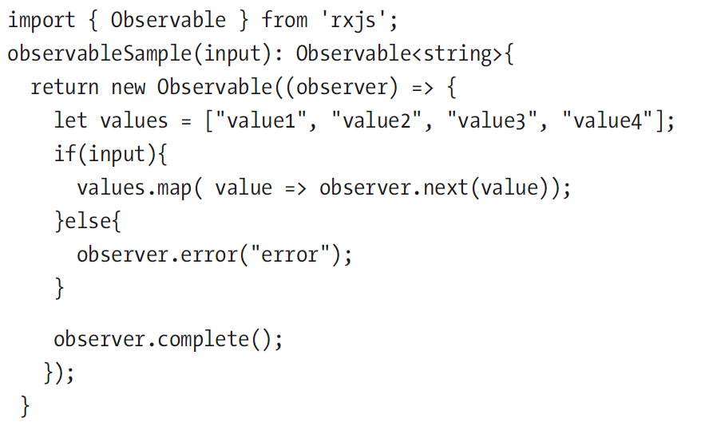
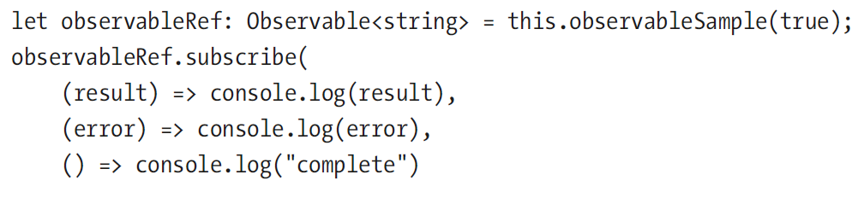
Angular for Material Design
7 - Angular: Services and Dependency Injection
create an observable
observable subscription

Slide 50
Angular for Material Design
Observables
Reactive X (http://reactivex.io/) is een library voor asynchroon en event gebaseerd te programmeren
Reactive X bestaat voor verschillende talen, RxJS is de versie voor javascript
Groovy: RxGroovy
JRuby: RxJRuby
Kotlin: RxKotlin
Swift: RxSwift
PHP: RxPHP
Elixir: reaxive
Dart: RxDart
ReactiveX for platforms and frameworks
RxNetty
RxAndroid
RxCocoa
Languages
Java: RxJava
JavaScript: RxJS
C#: Rx.NET
C#(Unity): UniRx
Scala: RxScala
Clojure: RxClojure
C++: RxCpp
Lua: RxLua
Ruby: Rx.rb
Python: RxPY
Go: RxGo

Slide 51
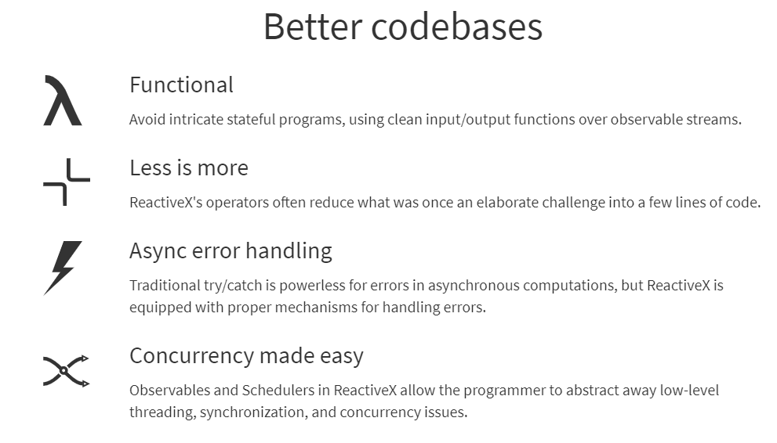
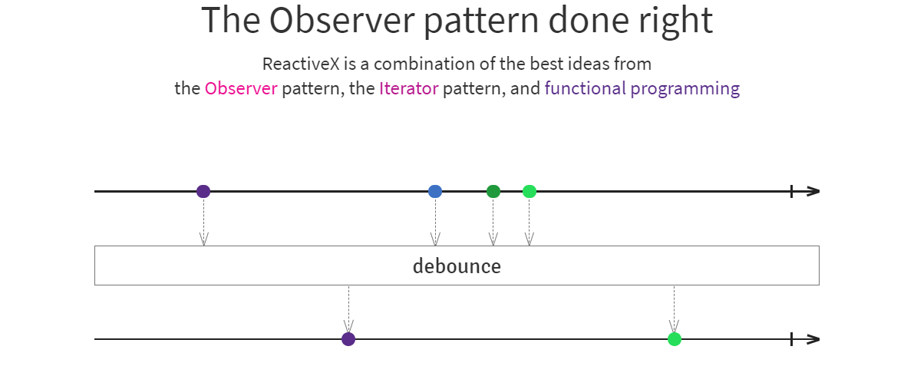
Angular for Material Design
Observables

Slide 52
Angular for Material Design
Observables
Observables maken het onderstaande raster compleet
 | Single | Multiple
Pull | Function | Iterator
Push | Promise | Observable
A Function is a lazily evaluated computation that synchronously returns a single value on invocation.
A generator is a lazily evaluated computation that synchronously returns zero to (potentially) infinite values on iteration.
A Promise is a computation that may (or may not) eventually return a single value.
An Observable is a lazily evaluated computation that can synchronously or asynchronously return zero to (potentially) infinite values from the time it's invoked onwards.

Slide 53
Angular for Material Design
Observables
hans-naert/observables (github.com)
Observables aanmaken – create
Observable gebruik - subscribe
var observable = new Observable(function(observer) {
observer.next(1);
observer.next(2);
observer.next(3);
setTimeout(() => { observer.next(4); observer.complete(); }, 1000);
});
console.log('just before subscribe');
observable.subscribe({
next: x => console.log('got value ' + x),
error: err => console.error('something wrong occurred: '+err),
complete: () => console.log('done'), });
console.log('just after subscribe');

Slide 54
Angular for Material Design
Observables
Resultaat
just before subscribe
got value 1
got value 2
got value 3
just after subscribe
got value 4
done

Slide 55
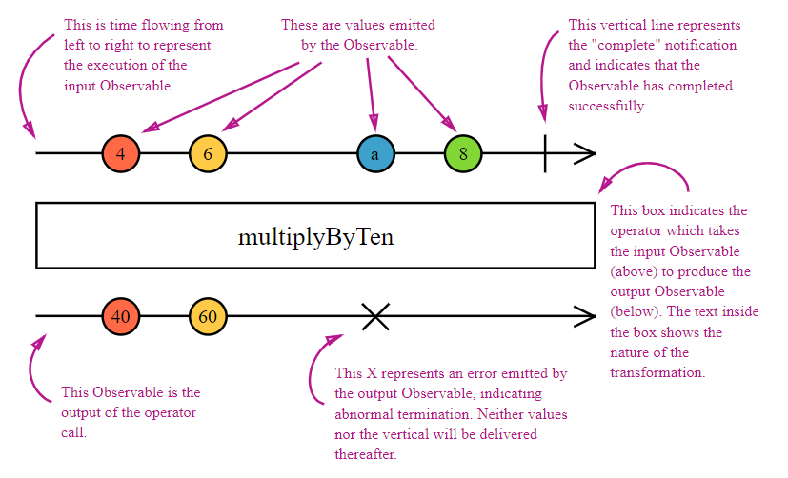
Angular for Material Design
Observables
Marble diagrams om de werking van operatoren voor te stellen

Slide 56
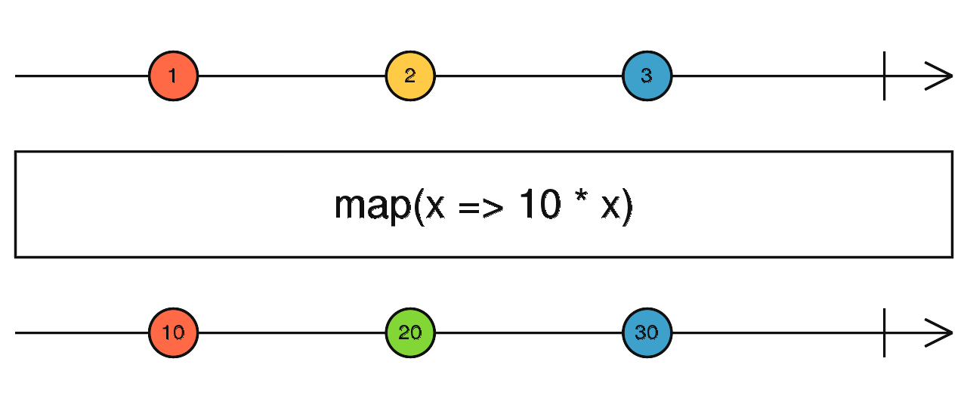
Angular for Material Design
Observables
map: https://rxjs-dev.firebaseapp.com/api/operators/map

Slide 57
Angular for Material Design
7 - Angular: Services and Dependency Injection
Angular Services
data die over de hele App nodig is (bvb superhero data)
functie die data verzameld en transformeert - zodat views via databinding de huidige data kunnen tonen
Create a service: ng generate service data-services/superhero-data

Slide 58
Angular for Material Design
7 - Angular: Services and Dependency Injection
Dependency injection in Angular
Provider for a service
Angular creëert injectoren
scope:
Root
Module
component
bron: Angular for Material Design

Slide 59
Angular for Material Design
Event.target.value
Cast naar HTMLInputElement nodig…
Typescript: getTargetValue(event: Event) { return (event.target as HTMLInputElement).value
Template code: Angular - Template type checking <input type="text" (input)="superheroName= $any($event.target).value;" />

Slide 60
Angular for Material Design
7 - Angular: Services and Dependency Injection
Service - injected at root - neem code over van angular-for-material-design/superhero-data.service.ts at master · Apress/angular-for-material-design (github.com) en voeg het superhero model toe
import { Injectable } from '@angular/core';
@Injectable({
providedIn: 'root'
})
export class SuperheroDataService {
getSuperheroes(): Array<Superhero> {
return [
{
// Superhero objects go here.
// removed code for brevity
},
constructor() {}
}

Slide 61
Angular for Material Design
7 - Angular: Services and Dependency Injection
Service - module level: in @NgModule({ providers :[ SuperheroDataService,
Service - component level: in @Component({providers :[SuperheroDataService,
Data van observable gebruiken:
import { SuperheroDataService } from 'src/app/data-services/superhero-data.service';
…
constructor(private dataService: SuperheroDataService) { }
ngOnInit(): void {
this.dataService.getSuperheroes().subscribe( data => console.log(data));
}

Slide 62
Angular for Material Design
7 - Angular: Services and Dependency Injection
Voorbeeld HitCounter
module level injection
component level injection

Slide 63
Angular for Material Design
7 - Angular: Services and Dependency Injection
Exercise
dataservice voor de dinosaurus data
provided op module niveau
asynchronously met promise of observable
logger service die dat de data afbeeldt in de console
provided op root niveau

Slide 64
Angular for Material Design
8 - Material Design: User Input
In dit hoofdstuk user input met text fields, single or multiselect drop-down, date controls, …
Material input elements

Slide 65
Angular for Material Design
8 - Material Design: User Input
Material Design Form Field
text field
text area
drop-down
chip input (selecting multiple items)
mat-form-field: appearance, floating labels, hint text and place holders
importeer in SuperheroesMaterialDesignModule: MatFormsModule en MatInputModule
maak component CreateSuperhero

Slide 66
Angular for Material Design
8 - Material Design: User Input
mat-form-field appearance

Slide 67
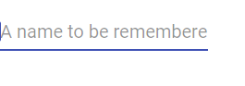
Angular for Material Design
8 - Material Design: User Input
Text Field within mat-form-field
Listing 8-6
<div>
<mat-form-field appearance="standard">
<input type="text" matInput placeholder="A name to be remembered" />
</mat-form-field>
</div>

Slide 68
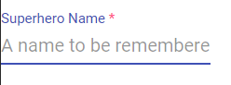
Angular for Material Design
8 - Material Design: User Input
Floating Label (auto => floats above when user focuses)
Listing 8-7
<mat-form-field floatLabel="auto" appearance="standard">
<mat-label>Superhero Name</mat-label>
<input type="text" required matInput placeholder="A name to be remembered" />
</mat-form-field>

Slide 69
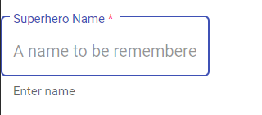
Angular for Material Design
8 - Material Design: User Input
Required Field
Listing 8-8
<div>
<!-- Appearance: Outline -->
<mat-form-field appearance="outline">
<mat-label>Superhero Name</mat-label>
<input type="text" matInput required placeholder="A name to be remembered" />
<mat-hint>Enter name</mat-hint>
</mat-form-field>
</div>

Slide 70
Angular for Material Design
8 - Material Design: User Input
Input Types with matInput
Date and time-related types: date, month, time, week, datetime-local
User data types: password, email, tel, url
Other freqently used types: number, search, color
Not supported types
checkbox => wel met MatCheckboxModule
file
hidden
image
radio
range
reset
submit

Slide 71
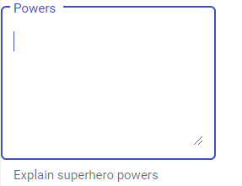
Angular for Material Design
8 - Material Design: User Input
Tekst Area Within mat-form-field
Listing 8-11
<mat-form-field appearance="outline">
<mat-label>Powers</mat-label>
<textarea rows="6" matInput></textarea>
<mat-hint>Explain superhero powers</mat-hint>
</mat-form-field>

Slide 72
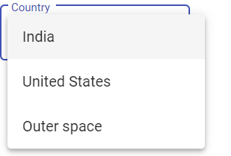
Angular for Material Design
8 - Material Design: User Input
Material Drop-downs
voeg MatSelectModule toe: import { MatSelectModule } from '@angular/material/select';
Listing 8-14
<div>
<!-- Appearance: Outline -->
<mat-form-field appearance="outline">
<mat-label>Country</mat-label>
<mat-select>
<mat-option>India</mat-option>
<mat-option>United States</mat-option>
<mat-option>Outer space</mat-option>
</mat-select>
</mat-form-field>
</div>

Slide 73
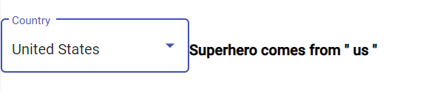
Angular for Material Design
8 - Material Design: User Input
Material Drop-downs
Listing 8-15 - value of mat-select
<div>
<!-- Appearance: Outline -->
<mat-form-field appearance="outline">
<mat-label>Country</mat-label>
<mat-select [(value)]="country">
<mat-option>None</mat-option>
<mat-option value="in">India</mat-option>
<mat-option value="us">United States</mat-option>
<mat-option value="os">Outer Space</mat-option>
</mat-select>
</mat-form-field>
<strong>Superhero comes from " {{country}} "</strong>
</div>

Slide 74
Angular for Material Design
8 - Material Design: User Input
Material Drop-downs
Listing 8-16 - Categorize
Listing 8-17 - Multiple select

Slide 75
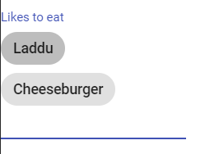
Angular for Material Design
8 - Material Design: User Input
Material Design: Chips
interface om één of meerdere items te selecteren
importeer de chips module import { MatChipsModule } from '@angular/material/chips';
Basic Chip List
<div>
<mat-form-field appearance="standard">
<mat-label>Likes to eat</mat-label>
<mat-chip-list #favFood>
<mat-chip> Laddu </mat-chip>
<mat-chip> Cheeseburger </mat-chip>
</mat-chip-list>
<input [matChipInputFor]="favFood" />
</mat-form-field>
</div>

Slide 76
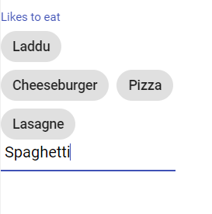
Angular for Material Design
8 - Material Design: User Input
Material Design: Chips
Listing 8-20: Add items Chip List
<mat-form-field appearance="standard">
<mat-label>Likes to eat</mat-label>
<mat-chip-list #favFood>
<mat-chip *ngFor="let item of items">
{{item}}
</mat-chip>
</mat-chip-list>
<input [matChipInputFor]="favFood" (matChipInputTokenEnd)="addItem($event)" matChipInputAddOnBlur />
</mat-form-field>
items: Array<string> = ["Laddu", "Cheeseburger", "Pizza"];
addItem(event: any) {
this.items.push(event.value);
}

Slide 77
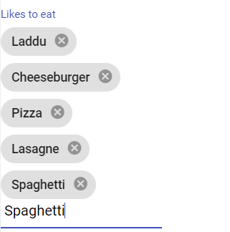
Angular for Material Design
8 - Material Design: User Input
Material Design: Chips
Listing 8-22: Remove items from a Chip List
removeHandler(item: string) {
this.items.splice(this.items.indexOf(item), 1);
}
<mat-form-field appearance="standard">
<mat-label>Likes to eat</mat-label>
<mat-chip-list #favFood>
<mat-chip *ngFor="let item of items" (removed)="removeHandler(item)">
{{item}}
<mat-icon matChipRemove>cancel</mat-icon>
</mat-chip>
</mat-chip-list>
<input [matChipInputFor]="favFood" (matChipInputTokenEnd)="addItem($event)" matChipInputAddOnBlur />
</mat-form-field>

Slide 78
Angular for Material Design
8 - Material Design: User Input
Exercise
Bouw een dinosaurus form
dinosaurus naam
dinosaurus family, met drop-down
Timeframe: text field met Mil-yrs-ago als postfix
Dinosaurus descriptie: text area: min 6 lijnen, max 20
Continents: chip list

Slide 79
Angular for Material Design
9 - Angular: Building Forms
data is input through a form - validated and saved in the backend
Angular framework has two options for creating forms
Template-driven forms: simple
Reactive forms: Model driven -> for complex forms

Slide 80
Angular for Material Design
9 - Angular: Building Forms
Template-Driven Forms
easy to build
asynchronous
data is mutable (change of the form -> change of the model object/Typescript class field)
voeg FormsModule toe (is vroeger reeds gedaan voor ngModel)
maak een superhero Model (vroeger reeds gedaan voor dataservices)
Listing 9-3: voeg het superhero Model toe aan CreateSuperhero
Listing 9-4: voeg een form toe: <form #superheroForm="ngForm">
#superheroForm: view variable - kan dan later in de view gebruikt worden
Listing 9-5: voeg de formfields toe en gebruik databinding met [(ngModel)] <input type="text" name="name" [(ngModel)]="superhero.name" matInput required placeholder="A name to be remembered" />
Listing 9-6: two way databinding van mat-select is mogelijk met value variabele <mat-select placeholder="select country" [(value)]="superhero.country">

Slide 81
Angular for Material Design
9 - Angular: Building Forms
Voeg Getter toe aan CreateSuperhero
get model() {
return JSON.stringify(this.superhero);
}
<strong>
{{model}}
</strong>
of {superhero | json} in de HTML template

Slide 82
Angular for Material Design
9 - Angular: Building Forms
Form validation and errors
listing 9-9: voeg attributes toe
required
minlength en maxlength
email

Slide 83
Angular for Material Design
9 - Angular: Building Forms
Using the State Field in Form Controls
touched/untouched
dirty/pristine
valid/invalid
<div>
<mat-form-field appearance="outline">
<mat-label>Email</mat-label>
<input type="text" name="email" email [(ngModel)]="superhero.email" matInput #email="ngModel"/>
<mat-hint>How do I contact the superhero for help?</mat-hint>
</mat-form-field>
</div>
<!-- Show error message to the user -->
<div class="error-message" *ngIf="!email.valid && email.touched">
Please enter a valid email address.
</div>

Slide 84
Angular for Material Design
9 - Angular: Building Forms
State of the Form
<form #superheroForm="ngForm">
<strong>
Form Status, Valid- {{superheroForm.valid}}. Pristine- {{superheroForm.pristine}}. Touched- {{superheroForm.touched}}
</strong>

Slide 85
Angular for Material Design
9 - Angular: Building Forms
Submit/save on an invalid form
in superheroes-material-design.module.ts: import toevoegen van "MatButtonModule"
<div>
<button mat-stroked-button> Cancel </button>
<button mat-stroked-button [disabled]="!superheroForm.valid"> Save
</button>
</div>

Slide 86
Angular for Material Design
9 - Angular: Building Forms
Reactive forms
Model driven: een data object bepaalt de form representatie
Immutable: iedere verandering => volledig nieuwe state (dus geen verandering aan de bestaande state)
Reactive forms laten unit testing toe - aanstuurbaar vanuit component
in superheroes-material-design.module.ts: import toevoegen van "ReactiveFormsModule"
ng g component superheroes-material-design/create-superhero-reactive-form

Slide 87
Angular for Material Design
9 - Angular: Building Forms
Create a Form Control with Form Builder
CreateSuperheroReactiveFormComponent.ts:
create-superhero-reactive-form.component.html:
// Create an instance of FormControl using the FormBuilder
name: FormControl = this.fb.control("");
// Inject FormBuilder
constructor(private fb: FormBuilder) { }
<mat-form-field appearance="outline">
<mat-label>Superhero Name</mat-label>
<input type="text" name="name" [formControl]="name" matInput placeholder="A name to be remembered" />
<mat-hint>Enter name</mat-hint>
</mat-form-field>

Slide 88
Angular for Material Design
9 - Angular: Building Forms
Capture Changes to the From Control
gebruikersacties => stroom van interacties => observable met valueChanges
change (na enter)
ngOnInit(): void {
this.name.valueChanges.subscribe( result => console.log(result));
}
<input type="text" name="name" [formControl]="name" matInput placeholder="A name to be remembered" (change)="changeHandler()"/>

Slide 89
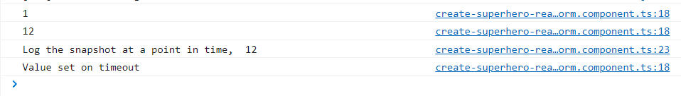
Angular for Material Design
9 - Angular: Building Forms
Form control instellen
mimic gedrag van instellen na API call (waarde met vertraging ter beschikking)
ngOnInit(): void {
this.name.valueChanges.subscribe( result => console.log(result));
setTimeout( () => this.name.setValue("Value set on timeout"), 1000);
}

Slide 90
Angular for Material Design
9 - Angular: Building Forms
Create a Form Group with Form Builder listing 9-23 en 9-24
// Class variable representing FormGroup.
superheroFormGroup: FormGroup;
// Inject FormBuilder
constructor(private fb: FormBuilder) {
// Create FormGroup object with FormBuilder.
this.superheroFormGroup = this.fb.group({
name: '',
email: '',
details: '',
powers: '',
country: ''
});
}
<form #superheroForm="ngForm" [formGroup]="superheroFormGroup">
<input type="text" name="name" formControlName="name" …

Slide 91
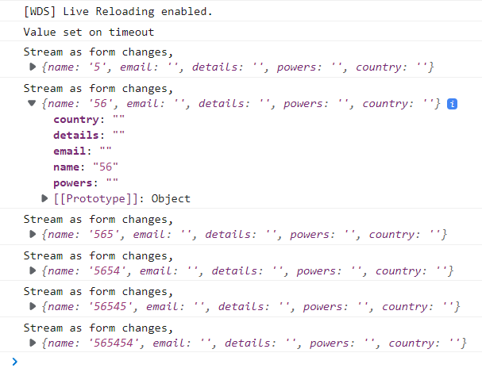
Angular for Material Design
9 - Angular: Building Forms
Read Form Group Values as a Stream listing 9-26
this.superheroFormGroup
.valueChanges
.subscribe(item =>
console.log("Stream as form changes, ", item as Superhero));

Slide 92
Angular for Material Design
9 - Angular: Building Forms
Read Form Group Values as a Snapshot listing 9-28 en 9-29
<form #superheroForm="ngForm" [formGroup]="superheroFormGroup"
(submit)="submitHandler()">

Slide 93
Angular for Material Design
9 - Angular: Building Forms
Form Validation listing 9-30, …, 9.34
// Create an instance of FormControl using the FormBuilder
name: FormControl = this.fb.control("", [Validators.required]);
// Inject FormBuilder
constructor(private fb: FormBuilder) {
// Create FormGroup object with FormBuilder.
this.superheroFormGroup = this.fb.group({
name: ['', Validators.required], email: ['', [ Validators.required, Validators.email]],
details: ['', [ Validators.minLength(5), Validators.maxLength(100)]],

Slide 94
Angular for Material Design
9 - Angular: Building Forms
Valid/Invalid listing 9-35, …, 9.36
get email(){
return this.superheroFormGroup
.get("email");
}
<mat-icon *ngIf="email?.valid" matSuffix >check_circle</mat-icon>
<mat-hint>How do I contact the superhero for help?</mat-hint>
</mat-form-field>
</div>
<div *ngIf="email?.invalid" class="error-message">
Invalid email. Use YourEMail@DomainName.com
</div>

Slide 95
Angular for Material Design
9 - Angular: Building Forms
touched/untouched listing 9-38
pristine/dirty
error vlag
<div *ngIf="email?.touched && email?.invalid" class="error-message">
Invalid email. Use YourEMail@DomainName.com
</div>
<strong>
Pristine: {{ email?.pristine }}. Dirty: {{ email?.dirty }}
</strong>
<div *ngIf="email?.errors?.required">
*Email is a required field
</div>

Slide 96
Angular for Material Design
10 - Material Design: Additional Form Fields
extra controls:
date picker
slider
toggle switches
checkboxes

Slide 97
Angular for Material Design
10 - Material Design: Additional Form Fields
Date picker
MatDatepickerModule
MatNativeDateModule
moment
npm install moment
npm install @angular/material-moment-adapter
Listing 10-3, 10-5
<input matInput formControlName="dob" [matDatepicker]="dateOfBirth" />
<!--mat-datepicker #dateOfBirth [opened]="true"></mat-datepicker-->
<mat-datepicker [opened]="true" startView="multi-year" #dateOfBirth ></mat-datepicker>
console.log("Selected date value ", moment(this.superheroFormGroup.value.dob).toDate());

Slide 98
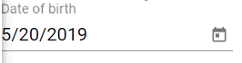
Angular for Material Design
10 - Material Design: Additional Form Fields
Toggle Date picker
Listing 10-9
<div>
<mat-form-field>
<mat-label>Date of birth</mat-label>
<input matInput formControlName="dob" [matDatepicker]="dateOfBirth" />
<!--mat-datepicker #dateOfBirth [opened]="true"></mat-datepicker-->
<mat-datepicker-toggle matSuffix [for]="dateOfBirth"></mat-datepicker-toggle>
<mat-datepicker startView="multi-year" #dateOfBirth></mat-datepicker>
</mat-form-field>
</div>

Slide 99
Angular for Material Design
10 - Material Design: Additional Form Fields
Date Picker
custom icon
filter dates: listing 10-11
custom filter: listing 10-14

Slide 100
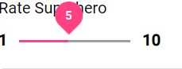
Angular for Material Design
10 - Material Design: Additional Form Fields
Slider, Listing 10-17,10-18,10-19
<div>
<div>
Rate Superhero
</div>
<div>
<strong> {{ minRating }} </strong>
<mat-slider formControlName="rating" [max]="maxRating" [min]="minRating" step="1" thumbLabel>
</mat-slider>
<strong> {{ maxRating }} </strong>
</div>
</div>

Slide 101

Angular for Material Design
10 - Material Design: Additional Form Fields
Toggle Switch and Check Box
voeg toe: MatSlideToggleModule en MatCheckboxModule
Listing 10-24, 10-25
<mat-slide-toggle checked="true" (change)="onToggleChange($event)" labelPosition="before" disableRipple="true">
Add a cape to the hero? </mat-slide-toggle>
onToggleChange(event: MatSlideToggleChange) {
console.log(event.checked);
}

Slide 102
Angular for Material Design
10 - Material Design: Additional Form Fields
Toggle Switch and Check Box
Listing 10-26, 10-27
let j = this.cities.map( i => new FormControl(i.selectedByDefault));
this.superheroFormGroup = new FormGroup( {
name: new FormControl('', Validators.required),
email:new FormControl('', [Validators.required, Validators.email]),
details: new FormControl('', [Validators.minLength(5),Validators.maxLength(100)]),
powers: new FormControl(''),
country: new FormControl(''),
dob: new FormControl(new Date('05/20/2019')),
rating: new FormControl(2),
jurisdiction: new FormArray(j)
});

Slide 103
Angular for Material Design
10 - Material Design: Additional Form Fields
Toggle Switch and Check Box
Listing 10-26, 10-27
<div formArrayName="jurisdiction">
<div *ngFor="let city of cities; let i=index;" >
<mat-slide-toggle [formControlName]="i">
{{cities[i].name}}
</mat-slide-toggle>
</div>
</div>
cities = [ {
name: "New York",
selectedByDefault: true
},{
name: "Boston",
selectedByDefault: false
},{
name: "Hyderabad",
selectedByDefault: false
}, {
name: "Bengaluru",
selectedByDefault: true
}];

Slide 104
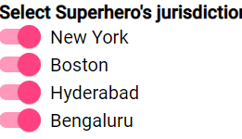
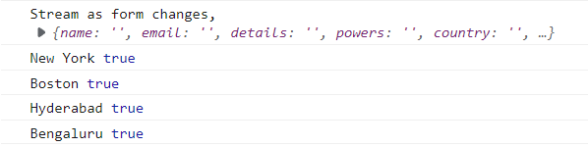
Angular for Material Design
10 - Material Design: Additional Form Fields
Toggle Switch and Check Box
Listing 10-26, 10-27
this.superheroFormGroup
.valueChanges
.subscribe(data => {
data.jurisdiction.map((value:boolean, it: number) => console.log(this.cities[it].name, value));
});

Slide 105
Angular for Material Design
10 - Material Design: Additional Form Fields
In the dinosaurs form, provide options to select the continents that a given dinosaur was found in. Create the form with the following toggle button options. Selecting at least one continent is mandatory.
North America
South America
Greater India
Europe
Arabia
Laurasia
Gondwanaland
Provide a date-of-discovery option. Do not allow the date to be prior to 1900. The date cannot be later than today (the current system date).

Slide 106
Angular for Material Design
11 - Angular: Routing
Meeste Angular Apps zijn SPA (single-page applications)
Navigeren tussen pagina's
gedeelte van de pagina wordt herladen
header, footer, naviagation sidebar, … worden enkel indien nodig herladen
Waarom routing?
gebruikers navigeren tussen de verschillende views en componenten
browsers gebruiken URL's en history data voor forward/backward functionaliteit
browsers gebruiken URL's om pagina's te bookmarken
Routing => URLs koppelen aan een view

Slide 107
Angular for Material Design
11 - Angular: Routing
gestart met template inclusief routing
@angular/router wordt geïnstalleerd
AppRoutingModule wordt gemaakt:
import { NgModule } from '@angular/core';
import { RouterModule, Routes } from '@angular/router';
const routes: Routes = [];
@NgModule({
imports: [RouterModule.forRoot(routes)],
exports: [RouterModule]
})
export class AppRoutingModule { }

Slide 108
Angular for Material Design
11 - Angular: Routing
AppModule importeert de routing module:
import { AppRoutingModule } from './app-routing.module';
@NgModule({
declarations: [
AppComponent
],
imports: [
BrowserModule,
AppRoutingModule,
SuperheroesMaterialDesignModule
],
providers: [],
bootstrap: [AppComponent]
})
export class AppModule { }

Slide 109
Angular for Material Design
11 - Angular: Routing
Route Configuration
URL gekoppeld aan een View
path: URL
component: Angular Component
const routes: Routes = [
{
path: "heroes",
component: SuperheroListComponent
},
{
path: "create-hero",
component: CreateSuperheroReactiveFormComponent
}
];

Slide 110
Angular for Material Design
11 - Angular: Routing
Router Outlet: placeholder waar de te tonen component wordt in getoond app.component.html:
<superhero-toolbar></superhero-toolbar>
<router-outlet>
</router-outlet>

Slide 111
Angular for Material Design
11 - Angular: Routing
<superhero-toolbar>
{{title}}
<a routerLink="/create-hero">
Create Hero
</a>
</superhero-toolbar>
<router-outlet>
</router-outlet>
Link to route
app.component.html: routerlink => App wordt niet volledig opnieuw geladen van server, enkel "navigeren"
superhero-toolbar.component.html:
<mat-toolbar color="primary">Superheroes
<ng-content></ng-content>
</mat-toolbar>

Slide 112
Angular for Material Design
11 - Angular: Routing
Route parameters Listing 11-11 en 11-12
constructor(private route: ActivatedRoute)
const routes: Routes = [
// Removed other routes for brevity
{
path: "hero/:superheroName ",
component: SuperheroComponent
}
];
ngOnInit() {
const heroNameParam = this.route.snapshot.params.heroName || "";
// find hero in a list of heroes.
this.hero = this.heroes.find( hero => hero.name.toLowerCase() ===
heroNameParam.toLowerCase());
}

Slide 113
Angular for Material Design
11 - Angular: Routing
Using an Observable to Read Route Param Listing 11-14
Link a Route with Parameters
<div *ngFor="let hero of heroes">
<a [routerLink]="['/hero', hero.name]">
<mat-card>
<!-- removed code for brevity -->
</a>
</div>

Slide 114
Angular for Material Design
11 - Angular: Routing
Default route, Listing 11-23
Undefined route
const routes: Routes = [
// Removed other routes for brevity
{
path: "",
redirectTo: "/heroes",
{
path: "**",
redirectTo: "/heroes"
}

Slide 115
Angular for Material Design
Oefening Dinosaurus route
Maak een component DinosourList, met een lijst van dinosaurussen. Deze component moet geopend worden met de default route.
Voorzie een route naar de individuele dinosaurussen: /dinosaur/:dinosaurName.

Slide 116
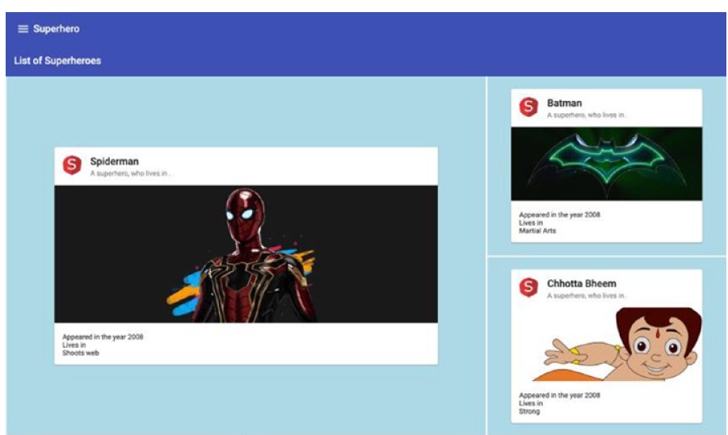
Angular for Material Design
hoofdstuk 12,13,14,15
12. Material Design: Navigation
Toolbar
Integration with Angular Router: routerLink=“/heroes“ => niet hele pagina opnieuw laden …
Sidenav
13. Material Design: Layout
Cards, Tabs, Expansion Panel
14. Material Design: Using Lists
List, Grid List
15. Material Design: Alerts and Dialogs

Slide 117
Angular for Material Design
16 – Angular HTTP Client
HTTP Client
For AJAX calls (XMLHttpRequest (XHR) over HTTP)
Met JSON
RESTful – GET, POST, PUT en DELETE

Slide 118
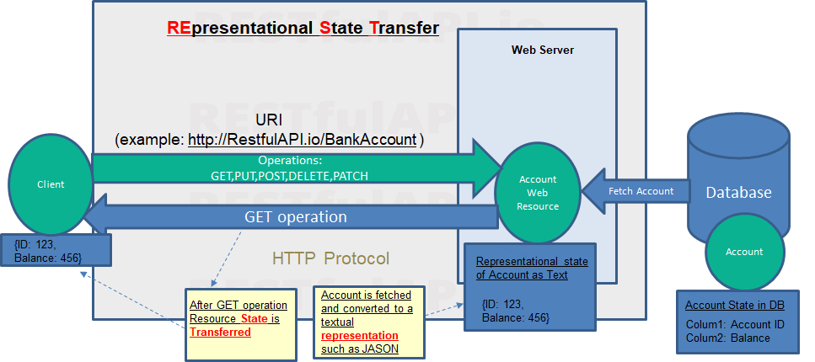
Angular for Material Design
16 – Angular HTTP Client
Restful

Slide 119
Angular for Material Design
16 – Angular HTTP Client
Restful
GET – gets the current state of the resource. Idempotent.
PUT – works on a single resource and for creation or changes of its state. Idempotent
DELETE – Deletes the specified object. Idempotent.
POST – works on a collection. Creates or updates a collection.
PATCH – updates a collection
Developers are often confused on PUT vs POST. As a general practice take advantage of idempotency of PUT and use it for creation and POST for update.

Slide 120
Angular for Material Design
16 – Angular HTTP Client
HTTP Method | Idempotency | Reason
GET | Idempotent | GET used for retrieving information, multiple retrieval does not change state of the resource. GET is Idempotent.
POST | Not Idempotent | POST could be used to create a resource. for this reason resource id is not mentioned in URI. Calling a POST method multiple times will create resources each time. So, POST is not Idempotent
DELETE | Idempotent | DELETE is used to delete a specific resource. Multiple attempt to DELETE yields the same result. DELETE is Idempotent.
PUT | Idempotent | PUT is used for update or replace the resource mentioned in URI. For this reasons, a resource id is generally mentioned in the URI. Attempt to update the same resource with same values multiple times does not change the state of that resource. PUT is Idempotent.
PATCH | Not Idempotent | PATCH is used to update a portion of the resource. PATCH is not Idempotent
Restful

Slide 121
Angular for Material Design
16 – Angular HTTP Client
Module “app-http-calls” aanmaken: ng g module app-http-calls
Generate a Service for Service Calls ng g service app-http-calls/superhero-data
Importeer HttpClientModule in AppHttpCalls
Importeer AppHttpCalls in AppModule

Slide 122
Angular for Material Design
16 – Angular HTTP Client
Mock data
npm install -g json-server
json-server data.json angular-for-material-design/data.json at master · hans-naert/angular-for-material-design (github.com)
SuperheroDataService (Listing 16-7)
Add component superhero-grid-list ng generate component superheroes-material-design/superhero-grid-list
Add route for component
path: "hero-grid-list",
component: SuperheroGridListComponent

Slide 123
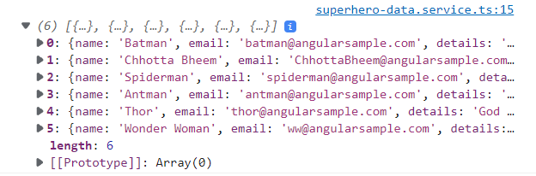
Angular for Material Design
16 – Angular HTTP Client
constructor(private heroService: SuperheroDataService) { }
ngOnInit(): void {
this.heroService.getHeroes();
}
in superhero-grid-list:
http://localhost:4200/hero-grid-list

Slide 124
Angular for Material Design
16 – Angular HTTP Client
in SuperheroDataService - listing 16.8 (with map)
getHeroes() {
let heroes: Observable<any> = this.httpClient.get(`${URL_PREFIX}/heroes`);
heroes.subscribe(
(data) => {
console.log(data.map((hero: any) => ({
"name": hero.name || "",
"email": hero.email || "",
"details": hero.details || "",
"country": hero.country || "",
"specialPowers": hero.specialPowers || [],
"cardImage": hero.cardImage || "/defaultImage.jpg",
"favFood": hero.favFood || []
})))
},
() => ({})/** Error handling callback */,
() => ({})/** Done with the observable */,
);;
}

Slide 125
Angular for Material Design
16 – Angular HTTP Client
in SuperheroDataService - listing 16.8 (with map) use subscribe with object
heroes.subscribe(
{next :(data) => {
...
},
error: () => ({})/** Error handling callback */,
complete: () => ({})/** Done with the observable */,
})

Slide 126
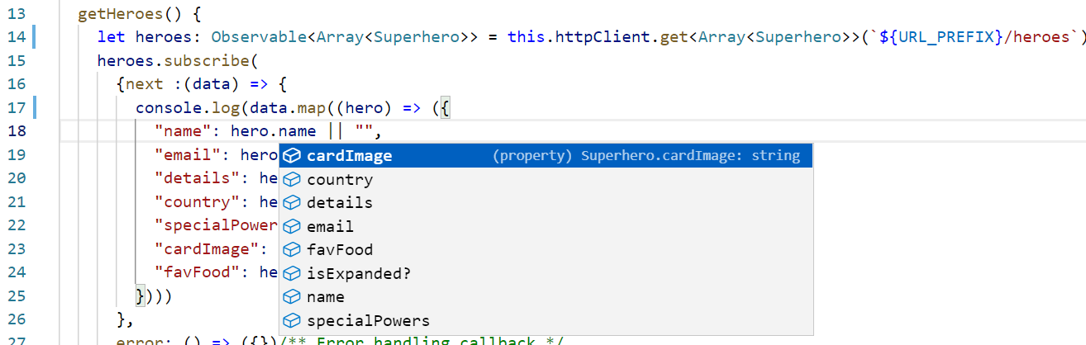
Angular for Material Design
16 – Angular HTTP Client
Explicitly Type Response Object - listing 16.8 (with map)

Slide 127
Angular for Material Design
16 – Angular HTTP Client
Return Observable from HTTP Client to the Calling Function - listing 16-10
Results from the Angular Service Assigned to a Class Variable - listing 16-11
Results from the Angular Service Assigned to a Class Variable - 16-12
<p>superhero-grid-list works!</p>
<mat-grid-list cols=1 rowHeight="100px">
<mat-grid-tile *ngFor="let hero of heroes; let i=index">
<mat-card>
{{hero.name}}
</mat-card>
</mat-grid-tile>
</mat-grid-list>

Slide 128
Angular for Material Design
16 – Angular HTTP Client
assigning Observable to Class variable
using observable in template
heroes: Observable<Array<Superhero>> | undefined;
ngOnInit(): void {
this.heroes=this.heroService.getHeroes();
}
<mat-grid-list cols=1 rowHeight="100px">
<mat-grid-tile *ngFor="let hero of heroes | async; let i=index">

